Slide 1
30
Money Growth and Inflation

Slide 2

Figure 1 Money Supply, Money Demand, and the Equilibrium Price Level
Value of
Price
Money,
1
/
P
Money supply
Level,
P
(High)
1
1
(Low)
3
/
1.33
4
A
1
/
2
2
Equilibrium
Equilibrium
value of
price level
1
/
4
money
4
Money
demand
(Low)
0
(High)
Quantity fixed
Quantity of
by the Fed
Money
Copyright © 2004 South-Western

Slide 3
Figure 2 The Effects of Monetary Injection
Value of
Price
Money,
MS₁
MS₂
Level,
P
1
/
P
(High)
1
1
(Low)
1. An increase
3
/
in the money
1.33
2. . . . decreases
4
supply . . .
the value of
3.
. . . and
mone
y . . .
A
increases
1
/
2
2
the price
level.
B
1
/
4
4
Money
demand
(Low)
(High)
0
M₁
M₂
Quantity of
Money
Copyright © 2004 South-Western

Slide 4
Figure 3 Money and Prices During Four Hyperinflations
(a) Austria
(b) Hungary
Index
Index
(Jan. 1921 = 100)
(July 1921 = 100)
100,000
100,000
Price level
10,000
Price level
10,000
Money supply
1,000
1,000
Money supply
100
1921
1922
1923
1924
1925
100
1921
1922
1923
1924
1925
Copyright © 2004 South-Western

Slide 5
Figure 3 Money and Prices During Four Hyperinflations
(c) Germany
(d) Poland
Index
Index
(Jan. 1921 = 100)
(Jan. 1921 = 100)
100,000,000,000,000
Price level
10,000,000
1,000,000,000,000
1,000,000
Price level
10,000,000,000
Money
100,000,000
supply
100,000
Money
1,000,000
10,000
supply
10,000
1,000
100
1
100
1921
1922
1923
1924
1925
1921
1922
1923
1924
1925
Copyright © 2004 South-Western

Slide 6
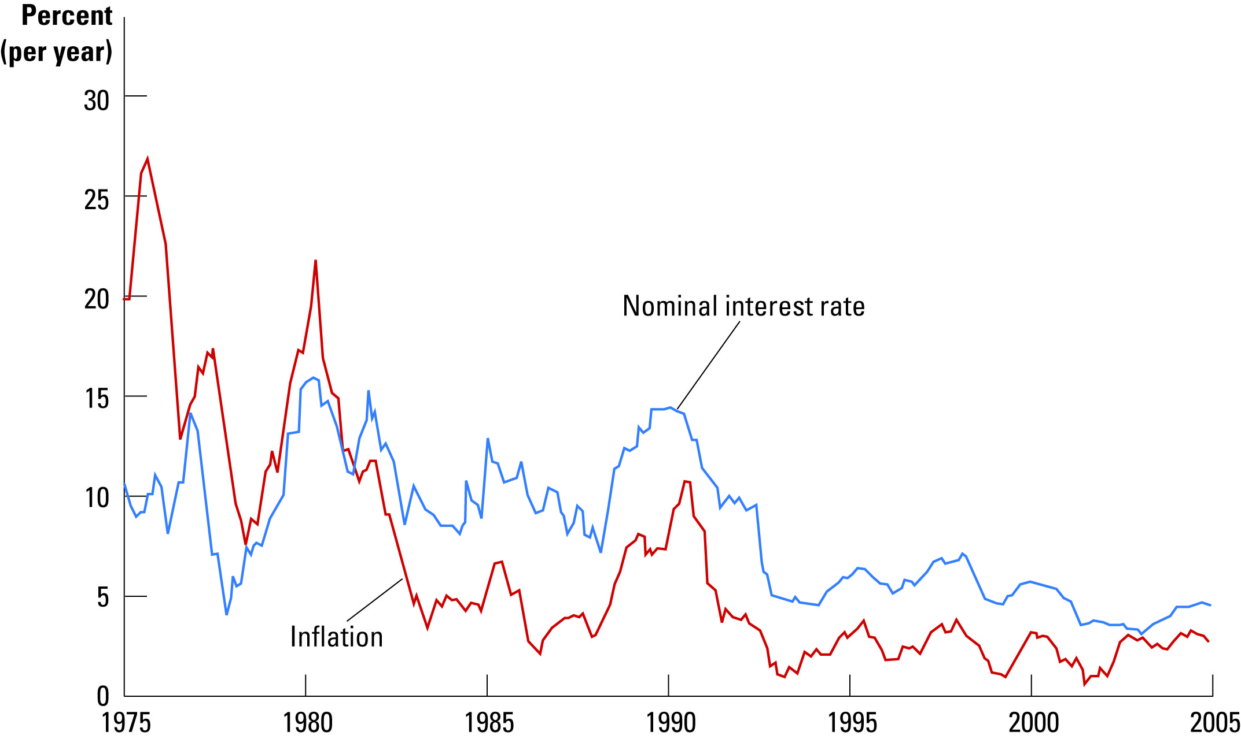
Figure 4 The UK Nominal Interest Rate and the Inflation Rate
Copyright © 2004 South-Western

Slide 7

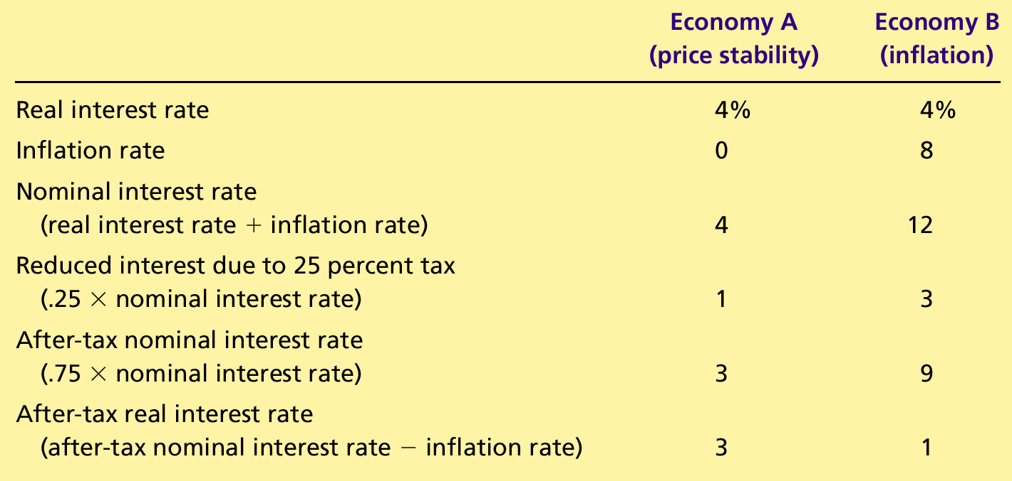
Table 1 How Inflation Raises the Tax Burden on Saving
Copyright©2004 South-Western

